Slide 1
Guide to Networking Essentials,
6th Edition
Chapter 9: Server Management and Administration

Slide 2
Objectives
Create and work with user and group accounts
Create and manage permissions on storage volumes
Work with shared files and printers
Monitor a system’s performance and reliability
Describe fault tolerant and backup solutions
Copyright © 2012 Cengage Learning. All rights reserved.

Slide 3
Managing User and Group Accounts
User accounts have two main functions:
  Provide a method for users to authenticate themselves
  to the network
  Provide detailed information about a user
Group accounts are used to organize users so that assignment of resource permissions and rights can be managed more easily than working with dozens or hundreds of individual user accounts
  Example: Group users by department within a company. When a shared folder containing documents used by a certain department is created, the admin just needs to assign permissions to the whole group.
Copyright © 2012 Cengage Learning. All rights reserved.

Slide 4
Managing User and Group Accounts
In a large network with many servers and hundreds or thousands of users, a scheme for naming user and group accounts as well as network devices is crucial. Consider the following:
  Is there a minimum and maximum number of characters user account names should have?
  Should the username be based on the user’s real name or if security is important, should names be more cryptic?
  Some OSs distinguish between uppercase and lowercase letters. Should usernames contain both as well as special characters?
Copyright © 2012 Cengage Learning. All rights reserved.

Slide 5
Managing User and Group Accounts
Considerations for password naming conventions:
  Minimum length
  Complexity requirements: use of uppercase and lowercase along with special characters
  User or administrator created
  Password change frequency
Group account names should reflect the group membership or the resource to which the group is assigned permissions
Once naming conventions have been established, stick to them
Copyright © 2012 Cengage Learning. All rights reserved.

Slide 6
Working with Accounts in Windows
When Windows is first installed, two users are created
  Administrator and Guest (usually disabled)
The Administrator account has full access to a computer
Windows domain users are created in Active Directory Users and Computers
You can create folders for organizing users and groups (called organization units or OUs)
Copyright © 2012 Cengage Learning. All rights reserved.

Slide 7
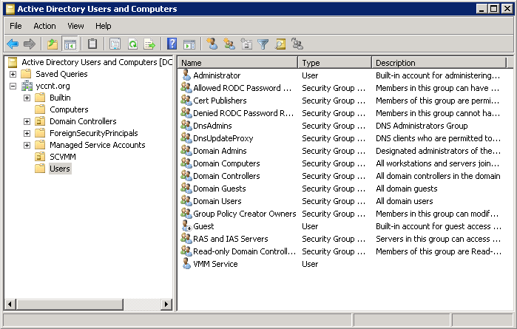
Working with Accounts in Windows
Active Directory Users and Computers
Copyright © 2012 Cengage Learning. All rights reserved.

Slide 8
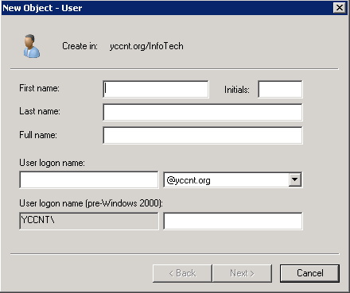
Working with Accounts in Windows
To create a new user:
Open the folder where you want
to create the user. Right-click the
folder, point to New, and click
User. The New Object – User
Dialog box opens
**Everything you create in Active
Directory is considered an object.
Copyright © 2012 Cengage Learning. All rights reserved.

Slide 9
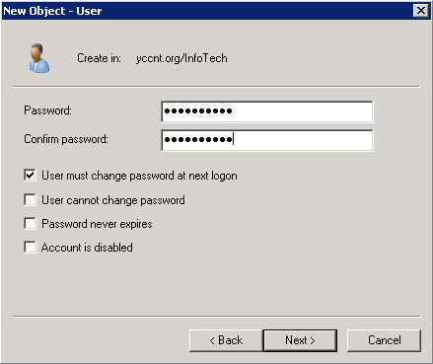
Working with Accounts in Windows
Setting the password and additional account options
Note – After a user account is created, you can double click it to open its properties
Copyright © 2012 Cengage Learning. All rights reserved.

Slide 10
Creating Group Accounts in Windows Domains
Group scope has three options:
  Domain local: Can be used to assign permissions to resources only in the domain in which the group is created
  Global: The default option; contains users from the domain in which they are created but can be assigned permissions to resources in other domains
  Universal: Used in multidomain networks; users from any domain can be members and be assigned permission to resources in any domain
Group type has two options:
  Security (default)
  Distribution: Used only for tasks such as sending all group members an e-mail when you run an Active Directory-integrated e-mail program, such as Microsoft Exchange
Copyright © 2012 Cengage Learning. All rights reserved.

Slide 11
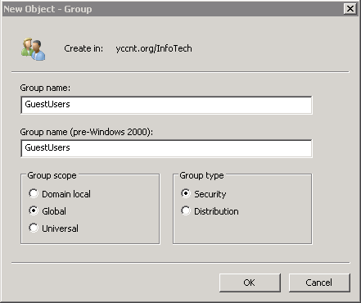
Creating Group Accounts in Windows Domains
Creating a new group in Active Directory
Copyright © 2012 Cengage Learning. All rights reserved.

Slide 12
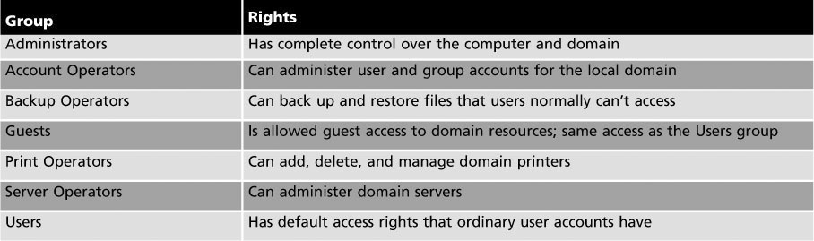
Windows Default Groups
Windows defines a number of default groups that have pre-assigned rights that apply to all group members
The following table lists those groups:
Copyright © 2012 Cengage Learning. All rights reserved.

Slide 13
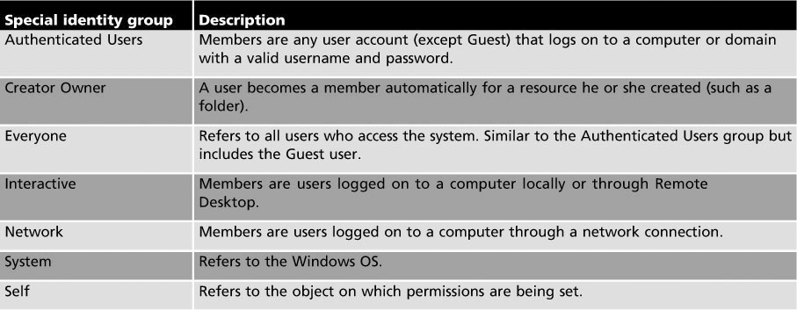
Special Identity Groups
Special identity groups don’t appear as objects in Active Directory Users and Computers, but they can be assigned permissions and rights
Membership is controlled by Windows
Copyright © 2012 Cengage Learning. All rights reserved.

Slide 14
User Profiles
User profile – collection of user’s personal files and settings that define his or her working environment
  Created when a user logs on for the first time and is stored in a folder that usually has the same name as the user’s logon name
A user profile stored on the same system where the user logs on is called a local profile
  When users log off, their profile settings are saved in their local profiles so that the next time they log on, all their settings are preserved
If administrators want to make a user’s profile available on any computer they log on to, they can set up roaming profiles
Copyright © 2012 Cengage Learning. All rights reserved.

Slide 15
User Profiles
A roaming profile follows the user no matter which computer he or she logs on to
  Stored on a network share
  Any changes the user makes to the profile are replicated from the locally “cached copy” to the profile on the network share when the user logs off
  Roaming profiles are rarely used in workgroup networks but are frequently used by Active Directory administrators
Mandatory profiles discard a user’s profile changes at log off so the profile is always the same
Copyright © 2012 Cengage Learning. All rights reserved.

Slide 16
Working with Accounts in Linux
User and group accounts in Linux are used for the same purpose as Windows:
  User authentication and authorization
Linux also has a default user who has full control over the system – named root
Most Linux administration takes place at the command line
  Adduser newuser (replace newuser with the logon name for the user account you’re creating)
  You will then be prompted to create a new password and enter the user’s full name and other information
Copyright © 2012 Cengage Learning. All rights reserved.

Slide 17
Working with Accounts in Linux
All users must belong to at least one group in Linux
  When a new user is created, a new group with the same name is also created and the user is made a member
Use the addgroup command to create groups
To add users to a group:
  Adduser username groupname
Many administrators prefer the command-line method for creating users because they can import user information from a text file
Copyright © 2012 Cengage Learning. All rights reserved.

Slide 18
Storage and File System Management
Network administrators need to:
  Make sure enough storage space is available to store files needed
  Manage who has access to file storage
  Prevent users from storing inappropriate types of data on company servers
Locally attached storage – a device, such as a hard disk, that is connected to a storage controller on the server
Copyright © 2012 Cengage Learning. All rights reserved.

Slide 19
Volumes and Partitions
A volume is part or all of the space on one or more disks that contains (or is ready to contain) a file system
  In Windows, volumes are usually assigned a drive letter
  In Linux, volumes are mounted in the file system and accessed as though they were a folder
The term partition is sometimes used interchangeably with volume but they don’t always describe the same thing
  In Windows, a basic disk can be divided into one to four partitions
  A primary partition can be formatted with a file system and assigned a drive letter (considered a volume)
  An extended partition can’t be formatted with a file system or assigned a drive letter. It is divided into one or more logical drives that can be formatted and assigned a drive letter (considered a volume)
Copyright © 2012 Cengage Learning. All rights reserved.

Slide 20
Volumes and Partitions
Only a primary partition can be the active partition (partition that can hold boot files)
The active primary partition storing the Windows boot loader is referred to as the system partition
The partition or logical drive holding the Windows OS files is called the boot partition
A dynamic disk can be divided into one or more volumes; the term partition is not used in this context
Copyright © 2012 Cengage Learning. All rights reserved.

Slide 21
The FAT File System
The File Allocation Table (FAT) file system has two variations:
  FAT16 is usually referred to as FAT and has been around since the mid-1980s and is supported by most OSs
  FAT32 arrived with the release of Windows 95 OSR2 in 1996
FAT16 is limited to 2 GB partitions in most cases
FAT32 allows partitions up to 2 TB but in Windows 2000 and later, Microsoft limits them to 32 GB because the file system becomes noticeably slower with larger partition sizes
Copyright © 2012 Cengage Learning. All rights reserved.

Slide 22
The NTFS File System
NTFS is a full-featured file system that Microsoft introduced in 1993 with Windows NT
Features available in NTFS that aren’t in FAT:
  Disk quotas: Limit amount of data users’ files can occupy
  Volume mount points: No need for a drive letter to access the volume
  Shadow copies: Allow users to restore older file versions or files that were accidentally deleted
  File compression: Files can be stored in a compressed format
  Encrypting File System: Makes encrypted files inaccessible to everyone except the user who encrypted the file, including users who have been granted permission to the file
Copyright © 2012 Cengage Learning. All rights reserved.

Slide 23
NTFS Permissions
Two modes for accessing files on a networked computer:
  Network (sometimes called remote)
  Interactive (sometimes called local)
Share permissions are applied when a user attempts network access to shared files
NTFS permissions always apply, whether file access is attempted interactively or remotely through a share
Permissions can be viewed as a gatekeeper to control who has access to folder and files
Copyright © 2012 Cengage Learning. All rights reserved.

Slide 24
NTFS Permissions
The general security rule for assigning permissions is to give users the least access necessary for their job
NTFS permissions can be configured on folders and files
By default, when permissions are configured on a folder, subfolders and files in that folder inherit the permissions but can be changed by the admin
To view or edit permissions on an NTFS folder, access the Security tab of the Properties dialog box
Copyright © 2012 Cengage Learning. All rights reserved.

Slide 25
NTFS Permissions
NTFS standard permissions for folders and files:
  Read: Users can view file contents, copy files, open folders and subfolders, and view file attributes and permissions.
  Read & execute: Grants the same permissions as Read and includes the ability to run applications or scripts.
  List folder contents: This permission applies only to folders and because it doesn’t apply to files, Read & execute must also be set on the folder to allow users to open files in the folder.
Copyright © 2012 Cengage Learning. All rights reserved.

Slide 26
NTFS Permissions (cont’d)
  Write: Users can create and modify files and read file attributes and permissions. However, this permission doesn’t allow users to read or delete files. In most cases, the Read or Read & execute permission should be given with the Write permission.
  Modify: Users can read, modify, delete, and create files. Users can’t change permissions or take ownership. Selecting this permission automatically selects Read & execute, List folder contents, Read, and Write.
  Full control: Users can perform all actions given by the Modify permission with the addition of changing permissions and taking ownership.
Copyright © 2012 Cengage Learning. All rights reserved.

Slide 27
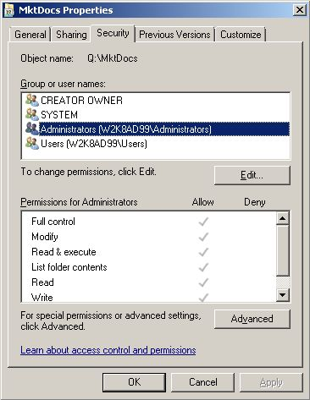
NTFS Permissions
Copyright © 2012 Cengage Learning. All rights reserved.

Slide 28
The Linux File System
Linux supports many files systems
  Ext3, Ext4, ReiserFS, and XFS
  Ext3 and Ext4 are the default file system for most Linux distributions
There are only three permissions – read, write, and execute
There are only three user types that can be assigned one or more permissions:
  Owner: Owner of the file or folder
  Group: The primary group to which the owner belongs
  Other: All other users
Copyright © 2012 Cengage Learning. All rights reserved.

Slide 29
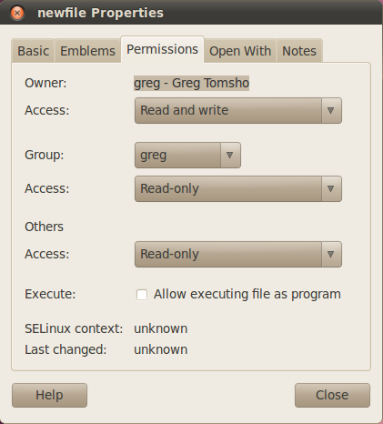
The Linux File System
Permissions for a file named “newfile” in Linux
Copyright © 2012 Cengage Learning. All rights reserved.

Slide 30
Working with Shared Files and Printers
The dominant file-sharing protocol is Server Message Block (SMB)
  This is the native Windows file-sharing protocol, but is supported by Linux and MAC OS
  Network File System (NFS) is the native Linux file-sharing protocol and Windows can support NFS with the right software installed
Printer sharing also uses SMB
  The native Linux printer-sharing protocol is line printer daemon/line printer remote (LPD/LPR)
Copyright © 2012 Cengage Learning. All rights reserved.

Slide 31
Sharing Files and Printers in Windows
In Windows, users are subject to both share and NTFS permissions when accessing files over the network
Share permissions are somewhat simpler than NTFS permissions. There are only 3:
  Read: Users can view contents of files, copy files, run applications and script files, open folders and subfolders, and view file attributes
  Change: All permissions granted by Read, plus create files and folders, change contents and attributes of files and folders, and delete files and folders
  Full Control: All permissions granted by Change, plus change file and folder permissions as well as take ownership of files and folders
Copyright © 2012 Cengage Learning. All rights reserved.

Slide 32
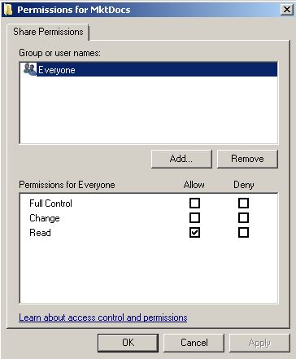
Sharing Files and Printers in Windows
Share Permissions
Copyright © 2012 Cengage Learning. All rights reserved.

Slide 33
Sharing Files and Printers in Windows
Sharing files isn’t difficult in a Windows environment. There are two methods:
  File Sharing Wizard: To start this wizard, right-click a folder and click Share (or “Share with” in Windows 7). The File Sharing Wizard (see next slide) simplifies sharing for novices by using easier terms for permissions and by setting NTFS permissions to accommodate the selected share permissions.
  Advanced Sharing dialog box: To open this dialog box, click Advanced Sharing in the Sharing tab of a folder’s Properties dialog box. There are quite a few options in this dialog box.
Copyright © 2012 Cengage Learning. All rights reserved.

Slide 34
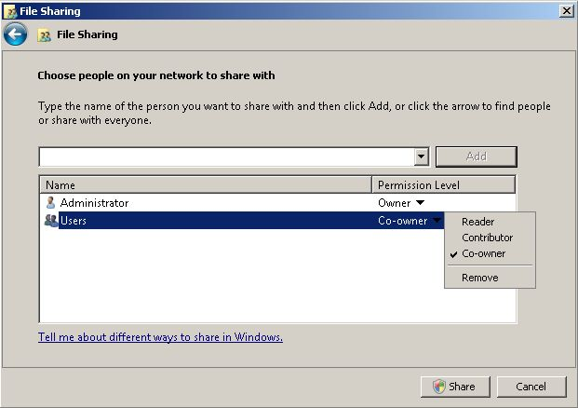
Sharing Files and Printers in Windows
  The File Sharing Wizard
Copyright © 2012 Cengage Learning. All rights reserved.

Slide 35
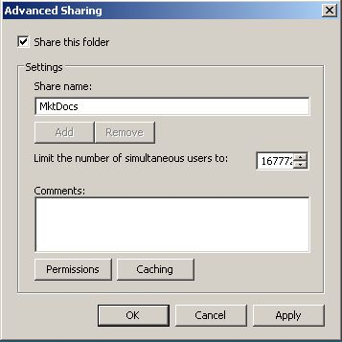
Sharing Files and Printers in Windows
The Advanced Sharing dialog box
Copyright © 2012 Cengage Learning. All rights reserved.

Slide 36
Sharing Printers in Windows
Components of a shared printer:
  Print device—Two basic types of print device:
    Local print device: Connected to an I/O port on a computer
    Network print device: A printer attached to and shared by another computer
  Printer: The icon in the Printers folder that represents print devices
  Print server: A Windows computer that’s sharing a printer
  Print queue: A storage location for print jobs awaiting printing
Copyright © 2012 Cengage Learning. All rights reserved.

Slide 37
Sharing Printers in Windows
Benefits of using a shared printer:
  Access control: Control who can print to a printer and who can manage print jobs
  Printer pooling: A single printer represents two or more print devices (server sends the job to the least busy printer)
  Printer priority: Two or more printers can represent a single print device (printers can be assigned different priorities so that a job sent to a higher priority will print first)
  Print job management: Administrators can pause, cancel, restart, reorder, and change preferences on print jobs waiting in the queue
  Availability control: Administrators can configure print servers so that print jobs are accepted only during certain hours of the day
Copyright © 2012 Cengage Learning. All rights reserved.

Slide 38
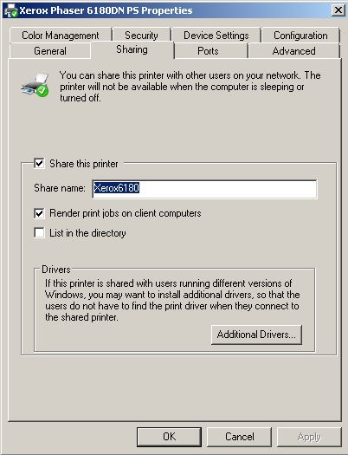
Sharing Printers in Windows
The Sharing tab for a print server
Copyright © 2012 Cengage Learning. All rights reserved.

Slide 39
Sharing Files and Printers in Linux
Linux supports Windows file sharing by using SMB in a software package called Samba
Printer sharing in Linux is straightforward after Samba has been installed
When you create a new printer in Linux, it is shared automatically
Copyright © 2012 Cengage Learning. All rights reserved.

Slide 40
Monitoring System Reliability and Performance
Windows Server 2008 provides tools to manage and monitor server operation:
  Task Manager
  Event Viewer
  Performance Monitor
  Windows System Resource Manager
We have already covered Task Manager so this section focuses on the other three
Copyright © 2012 Cengage Learning. All rights reserved.

Slide 41
Event Viewer
Allows administrators to view event log entries. Events are categorized by these levels:
  Information: These events indicate normal operations, such as service stops and starts
  Warning: Provide information about events that should be brought to the administrator’s attention
  Error: Error events are often generated when a process or service is unable to perform a task or stops unexpectedly
You can examine several log files in Event Viewer, including Application, Security, Setup, and System logs
Copyright © 2012 Cengage Learning. All rights reserved.

Slide 42
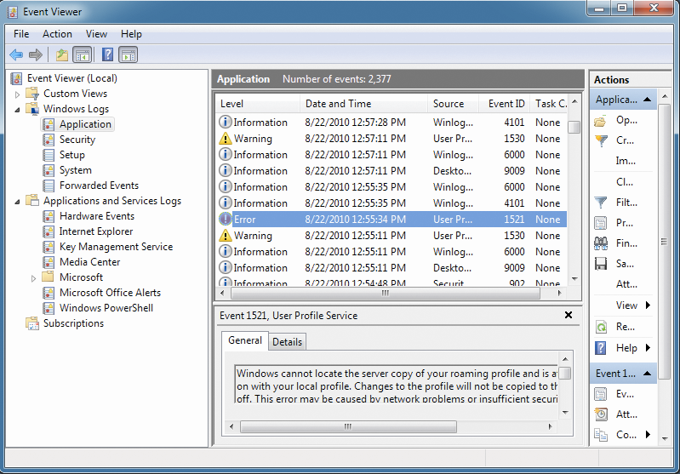
Event Viewer
Copyright © 2012 Cengage Learning. All rights reserved.

Slide 43
Performance Monitor
Consists of a collection of tools for pinpointing which resources are being overloaded and how they’re being overloaded
Contains the following folders:
  Monitoring Tools: Contains the Performance Monitor tool
  Data Collector Sets: Contains user- and system-defined templates with sets of data points called data collectors
  Reports: Contains system- and user-defined performance and diagnostic reports
Performance Monitor uses counters to track the performance of a variety of objects
  A counter is a value representing some aspect of an object’s performance
Copyright © 2012 Cengage Learning. All rights reserved.

Slide 44
Performance Monitor
In order to track an object’s performance you need to create a baseline
  Performance baseline is a record of performance data gathered when a system is performing well under normal operating conditions
  Generally, baseline data is collected shortly after a system is put into service and then again each time changes are made
To create a baseline of performance data, you create a data collector set that specifies the performance counters you want to collect, how often to collect them, and the time period
Copyright © 2012 Cengage Learning. All rights reserved.

Slide 45
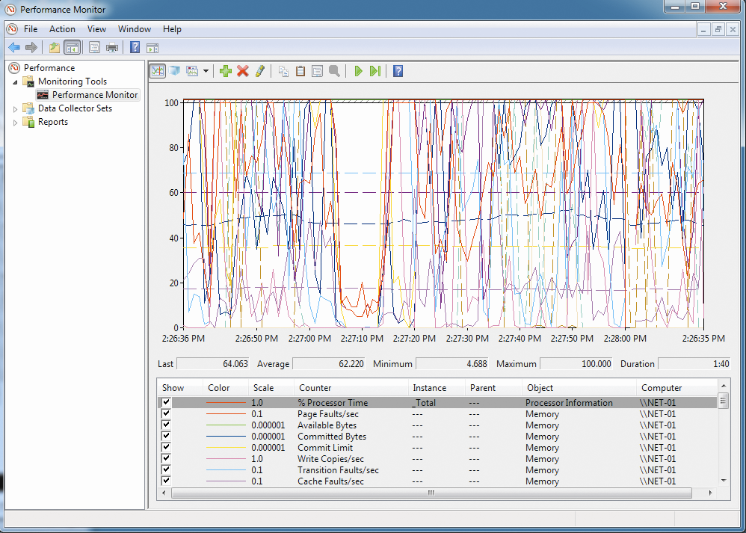
Performance Monitor
Copyright © 2012 Cengage Learning. All rights reserved.

Slide 46
Windows System Resource Manager
WSRM is a Windows Server 2008 feature installed in Server Manager that helps you manage processor and memory resources
WSRM includes the following features:
  Preconfigured and custom policies that allocate resources on a per-process or per-user basis
  Policies based on calendar rules to allow fine-tuning system resource use according to time of day
  Automatic policy application based on server events or changes in memory or CPU resources
  Resource monitoring data stored in a Windows internal database or SQL database
Copyright © 2012 Cengage Learning. All rights reserved.

Slide 47
Backup and Fault Tolerance
Regular backups provide a safety net to restore a system to working order in the event of a disk failure or file corruption
A popular type of backup is an image backup, in which a copy of an entire disk is created that can be restored without reinstalling the OS
  Can’t restore separate files so image backups are usually done along with traditional file backup
Fault tolerance provides methods for a system to continue running after a system failure has occurred
Copyright © 2012 Cengage Learning. All rights reserved.

Slide 48
Windows Backup
Windows Server Backup comes with Windows Server 2008 and has the following features:
  Backups can be run manually or scheduled to run automatically
  You can create a system recovery backup that automatically includes all volumes containing critical system data
  Manual backups can be stored on network drives, fixed and removable basic disk volumes and CD or DVD
  Backups can be stored on a hard disk dedicated for backups, a non-dedicated volume, or a shared network folder
  You can use a Volume Shadow Copy Service (VSS) backup, which means even open files can be backed up
  By default, Windows Server Backup is configured to back up the local computer, but you can also back up files remotely
Copyright © 2012 Cengage Learning. All rights reserved.

Slide 49
Windows Backup
Windows Server Backup is a satisfactory tool but it has limitations
  An enterprise-class backup program, such as Symantec NetBackup and CommVault Galaxy Backup and Recovery, offers advanced disaster recovery solutions
Windows 7 backup is called Backup and Restore and has straightforward features
  You can use it to create a system image, create a system repair disc, or back up all files or separate files and folders
Copyright © 2012 Cengage Learning. All rights reserved.

Slide 50
Protecting Data with Fault Tolerance
Recall that fault tolerance provides methods for a system to continue running after a system failure has occurred
Three forms of fault tolerance that are common on networks and servers:
  Redundant power supply and uninterruptible power supply
  Redundant disk systems
  Server clustering
Copyright © 2012 Cengage Learning. All rights reserved.

Slide 51
Redundant Power
A computer requires a constant, clean source of power or else it may reboot causing lost work or damage to the file system
A redundant power supply is a second power supply unit in the computer case, so if one power supply fails, the other unit takes on the full load
An uninterruptible power supply (UPS) is a device with a built-in battery, power conditioning, and surge protection
  If power fails, the UPS battery provides enough power to keep your computer running until power is restored or you can shut down the computer safely
Copyright © 2012 Cengage Learning. All rights reserved.

Slide 52
Redundant Power
UPSs come in two main categories: online and standby
A standby UPS supplies power to plugged-in devices by passing power from the wall outlet directly to the device
  In a power outage, the UPS detects the power failure and switches to battery power
  If switchover doesn’t happen fast enough, the plugged-in devices might lose power long enough to reboot
An online UPS supplies power continuously to plugged-in devices through the UPS battery, which is recharged continually by the wall outlet power
Copyright © 2012 Cengage Learning. All rights reserved.

Slide 53
Redundant Disk Systems
Redundant disk systems are based on the redundant array of independent disks (RAID) technology
RAID 1: Disk Mirroring – requires two disks
  When data is written to one disk, it’s also written to the second disk
  If either disk fails, the system can continue operating because both disks have the same data
RAID 5: Disk Striping with Parity – requires a minimum of three disks but is more space efficient than RAID 1
  Works by spreading data across multiple disks and using one disk in each write operation to store parity information
  Parity info is generated by a calculation on data being written, so if one of the disks fails, it can be used to re-create lost data from the failed disk
Copyright © 2012 Cengage Learning. All rights reserved.

Slide 54
Server Clustering
A server cluster is made up of two or more servers that are interconnected and appear as a single unit
Two common types of clustering are failover and load-balancing
  A failover cluster involves two or more servers sharing a
  high-speed link used to synchronize data. One server is the primary and others are standby. In the event the primary fails, a standby server takes its place.
  A load-balancing cluster consists of two or more servers that appear as a single unit to users. All servers in the cluster operate and share the load.
Copyright © 2012 Cengage Learning. All rights reserved.

Slide 55
Chapter Summary
User accounts are the link between real people and network resources
User accounts and passwords should have conventions for their creation
Group accounts are used to organize users so that assignment of resource permissions and rights can be managed more easily than working with dozens or hundreds of individual user accounts
A user profile is a collection of a user’s personal files and settings that define his or her working environment
Copyright © 2012 Cengage Learning. All rights reserved.

Slide 56
Chapter Summary
Locally attached storage is a device, such as a hard disk, connected to a storage controller on the server. Storage is divided into volumes or partitions
The Linux file systems include Ext3, Ext4, ResierFS, and XFS
SMB is the Windows default file-sharing protocol while NFS is the native Linux file-sharing protocol
Windows Server 2008 provides tools to manage and monitor server operation and resources, including the following: Task Manager, Event Viewer, Performance Monitor, Windows System Resource Manager
Copyright © 2012 Cengage Learning. All rights reserved.

Slide 57
Chapter Summary
Regular backups provide a safety net to restore a system to working order in the event of a disk failure or file corruption. Fault tolerance provides methods for a system to continue running after a system failure has occurred
Copyright © 2012 Cengage Learning. All rights reserved.

